Slide 1
Team 1 Thermostat
Abdulaziz Alhassan,
Damini Ashok Chopra
Konstantino Sparakis,
Xinzhu Xu,
Wenyng Zhang

Slide 2
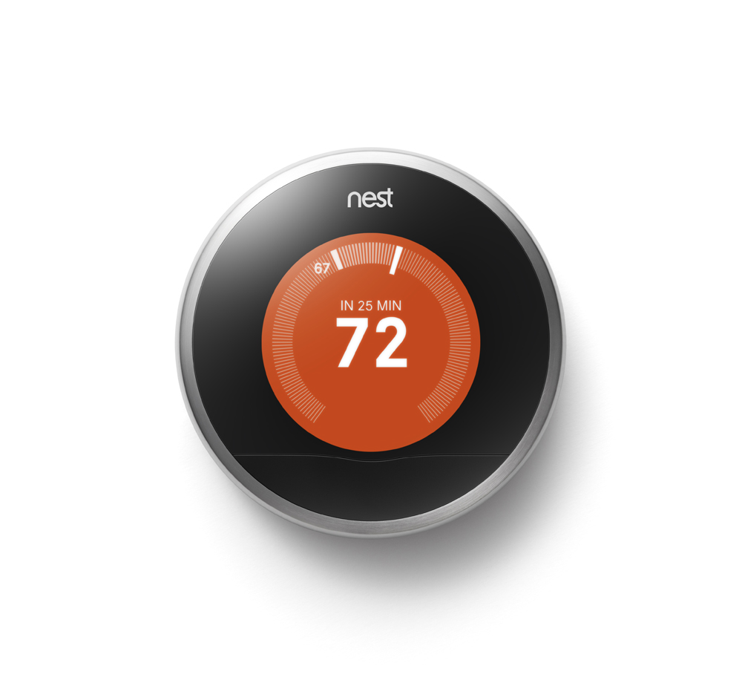
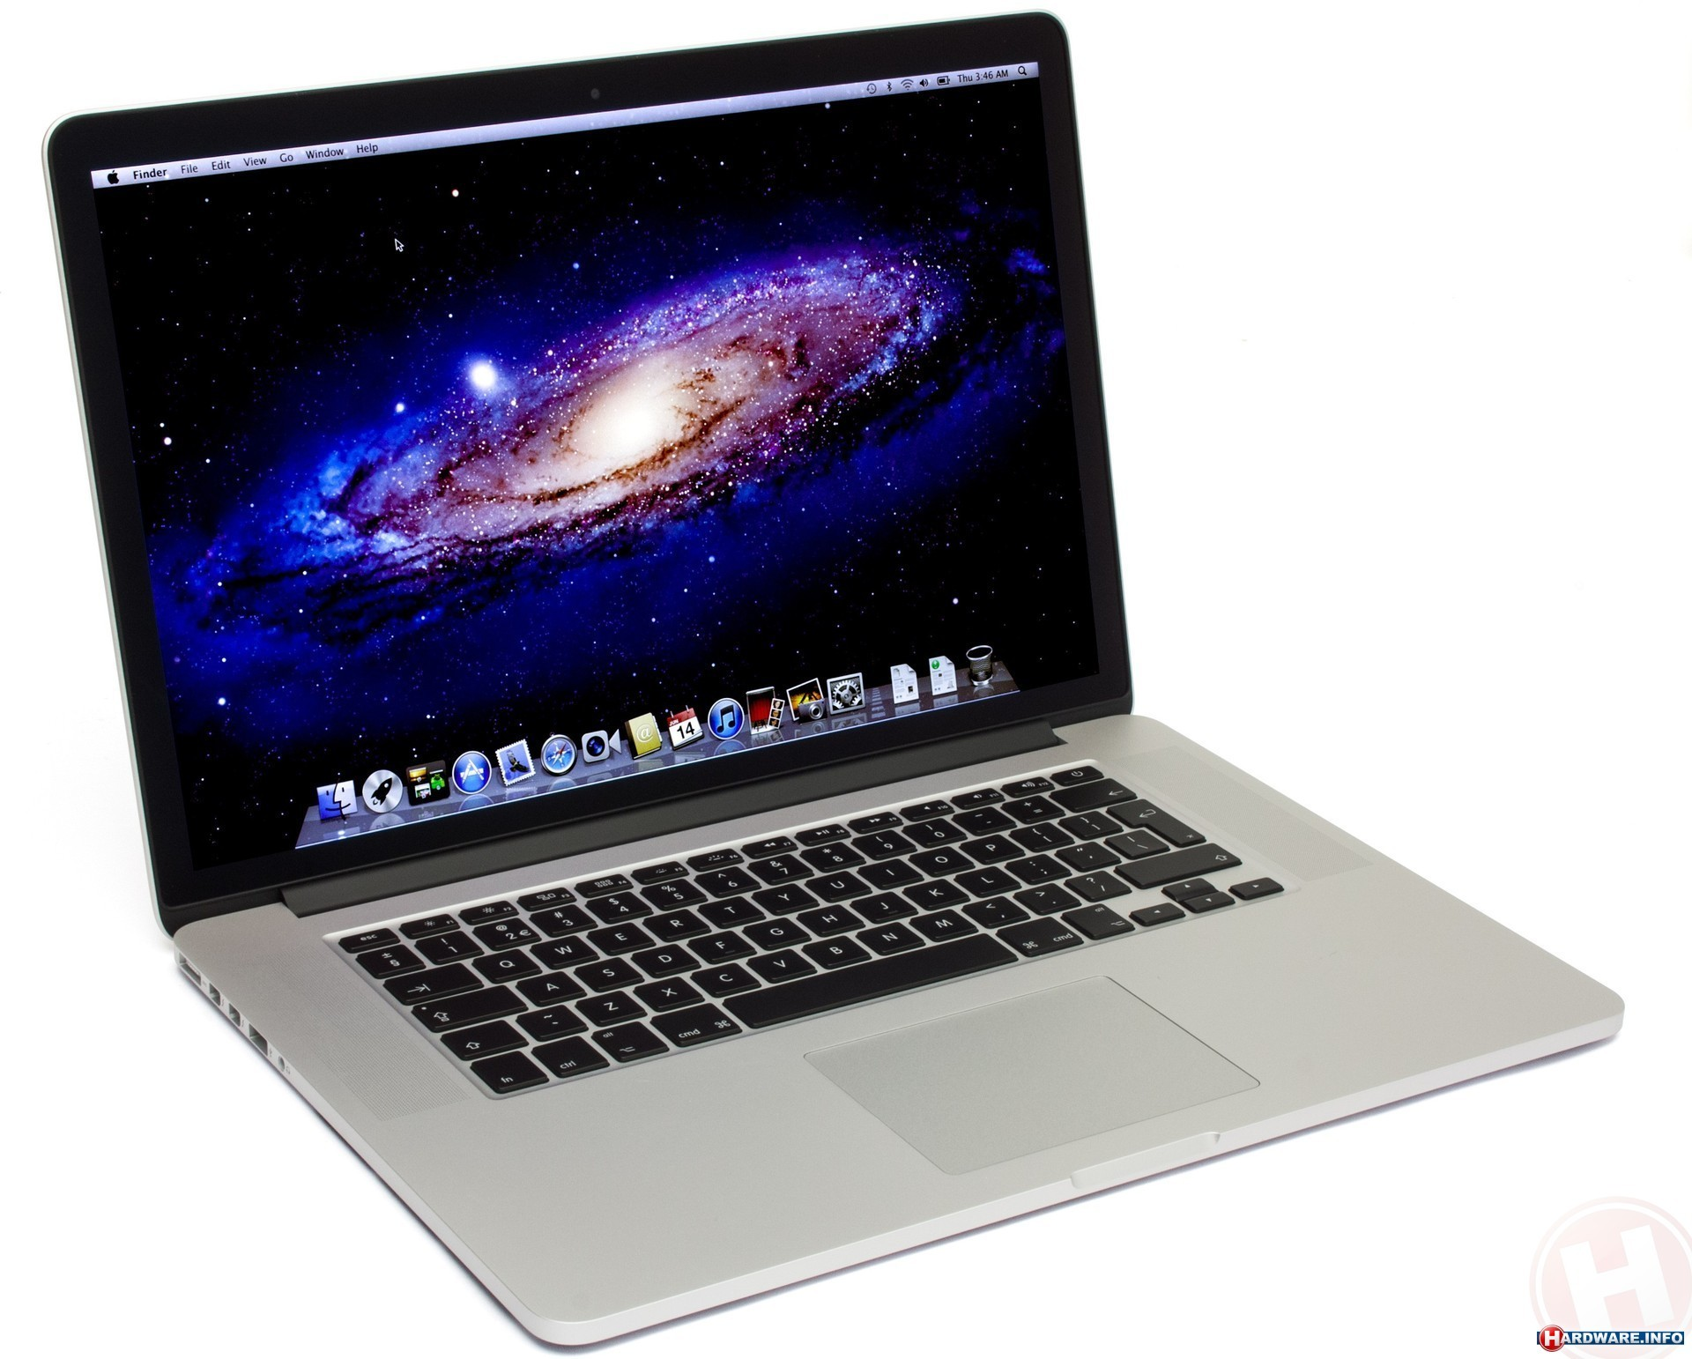

Design
Temperature measured every 1min then transmit to Base Station.
Calibration performed Server Side
An additional handshake scheme for synchronizing (later tasks)
Coded for Variable Device connections.

Slide 3


Data Flow
Data is stored in a local MySql Database managed by Xampp.
Data is collected by the Basestation and using an Http post in java is sent to PHP.
Why did we choose this method?

Slide 4
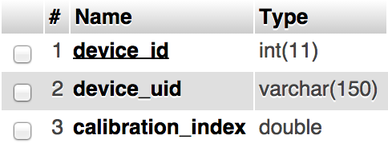
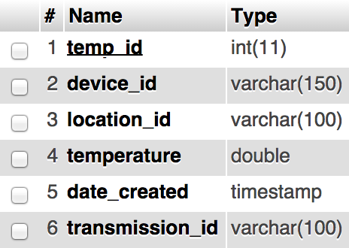
Table devices
Calibration index is added to the original value.
Allows for fast querying of data related to specific device or group.
Allows for querying over a specific time
Table data_post

Slide 5
Challenges
Learning Ant Command Line Tools
Working together as a team
Understanding which port to select
Mac OSX – Network Utilities Port Sniffer
Demo did not run at first

